Slide 1

Facial Emotion Recognition
by
Venkatesh V
Roll No. 184G1A05B1
Veena T
Roll No. 184G1A05A9
Sai Lahari K
Roll No. 184G1A0574
Under the guidance of
Mrs. M Soumya _{MTech, (Ph .D)}
Assistant Professor
Department of Computer Science and Engineering
Srinivasa Ramanujan Institute of Technology
(Affiliated to JNTUA & Approved by AICTE) (Accredited by NAAC with ‘A’ Grade & Accredited by NBA (EEE, ECE & CSE)
Rotarypuram Village, B K Samudram Mandal, Ananthapuramu – 515701.
2021 - 2022

Slide 2
Abstract
Facial Emotion Recognition using Convolution Neural Network .It is useful to detect the current emotion of the person. By using the datasets we can train and detect the human emotion.
Emojis are ways to indicate nonverbal cues. These cues have become an essential part of online chatting, product review, brand emotion, and many more. With advancements in computer vision and deep learning, it is now possible to detect human emotions from images .
When we will be in front of the camera it detects our face by creating a bounding box and it compares with the dataset that we have created and displays the corresponding emotion.

Slide 3

Contents
Introduction
Existing System
Proposed System
Problem Definition
Requirements to Develop / implement a project
Flow Diagram
Implementation
Result
Conclusion
References

Slide 4
Introduction
Face detection is implemented in many areas for security purpose . Along with face detection, the emotion of the face is detected in facial emotion recognition.
We can use this for the automatic capturing of the image based on the dataset given to the system. It can also be used for business purpose like product reviews and feedback forms and can also be used in online classes to detect the expressions of the students.

Slide 5
Existing System
Some algorithms have already proposed for facial emotion recognition like Support Vector Machine . It classifies the given data points and recognize the emotion.
By using Dlib library they have created landmarks on the face to detect the facial emotion. In Dlib library we have 68 facial landmark detector which gives the position of 68 landmarks on the face.
They also used K-Nearest neighbour algorithm ,which is one of the simplest ML algorithm based on supervised learning . K-NN algorithm is also known as Lazy Learner Algorithm.
They used to detect only single face emotion detection at a time.

Slide 6
Proposed System
They have detected single face emotion at a time, but we try to detect multiple facial emotions at a time.
To detect the multiple facial emotions, we can use some different algorithms like Convolutional Neural Network which is used to recognize the facial emotions.
We can use open CV library to capture the face and also use Numpy and Keras libraries in our project.

Slide 7
Problem Definition
Human emotions and intentions are expressed through facial expressions and deriving an efficient and effective feature is the fundamental component of facial expression system.
Facial expressions convey non-verbal cues, which play an important role in interpersonal relations.
Automatic recognition of facial expressions can be an important component of natural human-machine interfaces.

Slide 8
Requirements
Operating System : Windows 10
Language : Python
Platform : Jupyter Notebook or IDLE or Pycharm
Libraries : OpenCV, Numpy , Keras, pillow, Tensorflow

Slide 9
Architecture
Training Phase
Dataset of images
Preprocessing
Feature Extraction
Trained model
Testing Phase
Input Image
Preprocessing
Feature Extraction
Model
Output

Slide 10
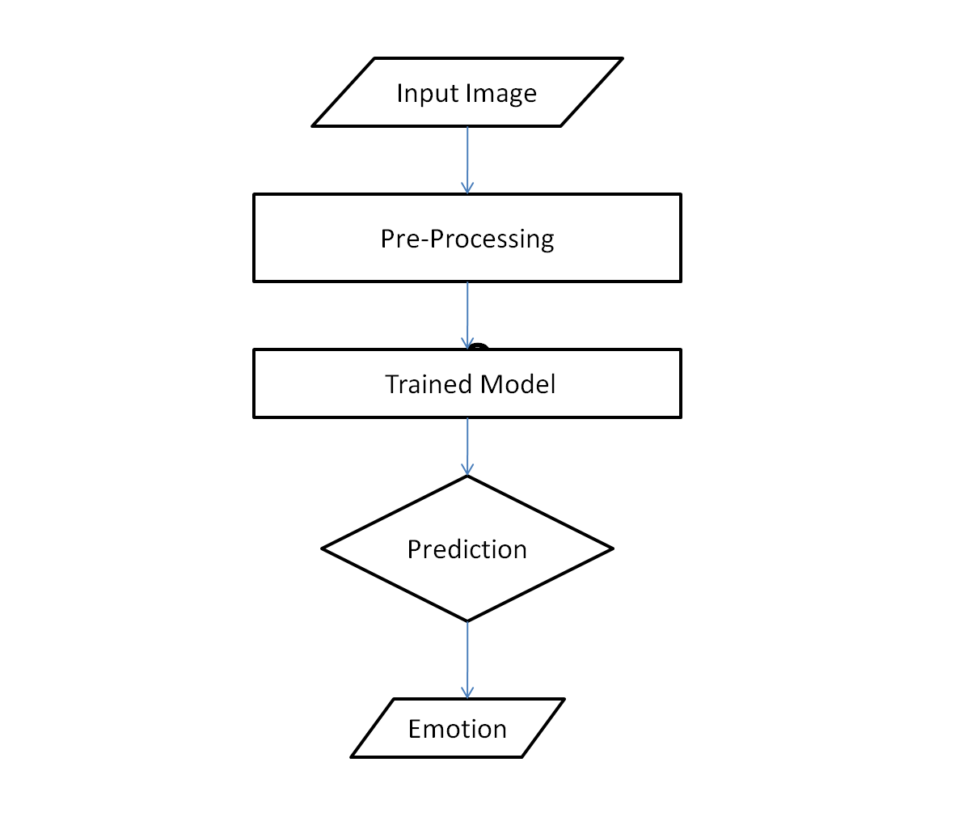
Flow Diagram

Slide 11
Implementation
By importing cv2 library , we are going to capture video.
#cap = cv2.Videocapture(0)
cap = cv2.videocapture(“Video file path”)
Creating the CNN Model:
emotion_model = Sequential()
emotion_model.add(Conv2D(32,kernel_size=(3,3),activation='relu',input_shape=(48, 48, 1)))
emotion_model.add(Conv2D(64,kernel_size=(3,3),activation='relu')) emotion_model.add(MaxPooling2D(pool_size=(2, 2)))
emotion_model.add(Dropout(0.25))

Slide 12
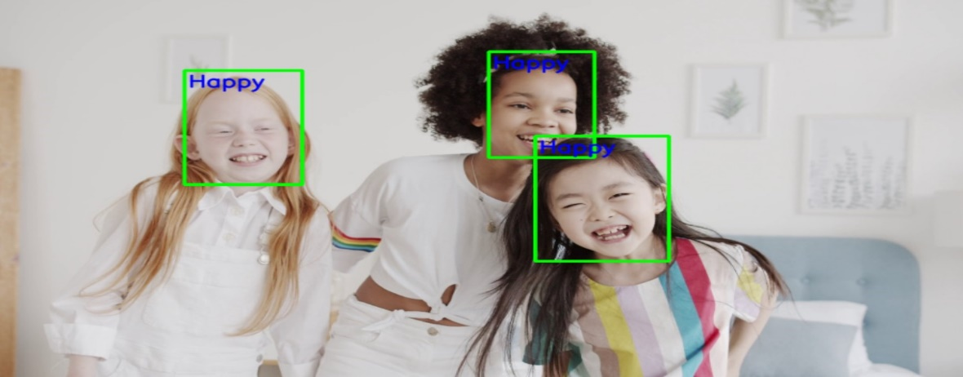
Contd..
Sample code for testing
import cv2
import numpy as np
Cap = cv2.Videocapture(0)
cap = cv2.videocapture(“Video file path”)
Face_detector=cv2.cascadeclassifier(‘haarcascades/haarcascade_frontalface_default.xml)
gray_frame = cv2.cvtColor(frame, cv2.CLOR_BGR2GRAY)
num_faces = face_detector.detectMultiScale(gray_frame, scaleFactor=1.3,minNeighbors=5)

Slide 13
Result
This proposed system uses a python platform with different libraries that are used for the implementation of the code.
Mainly, here we are using OpenCV library with many functions. It is easy to deal with the image transactions.
The application imports the Open CV library to solve the computer vision problems. OpenCV library method is mainly used to detect the objects and tracking of the objects.
For testing the images, we used the FER dataset .This dataset contains approximately 35,000 images, with each image defined in the original expression.

Slide 14
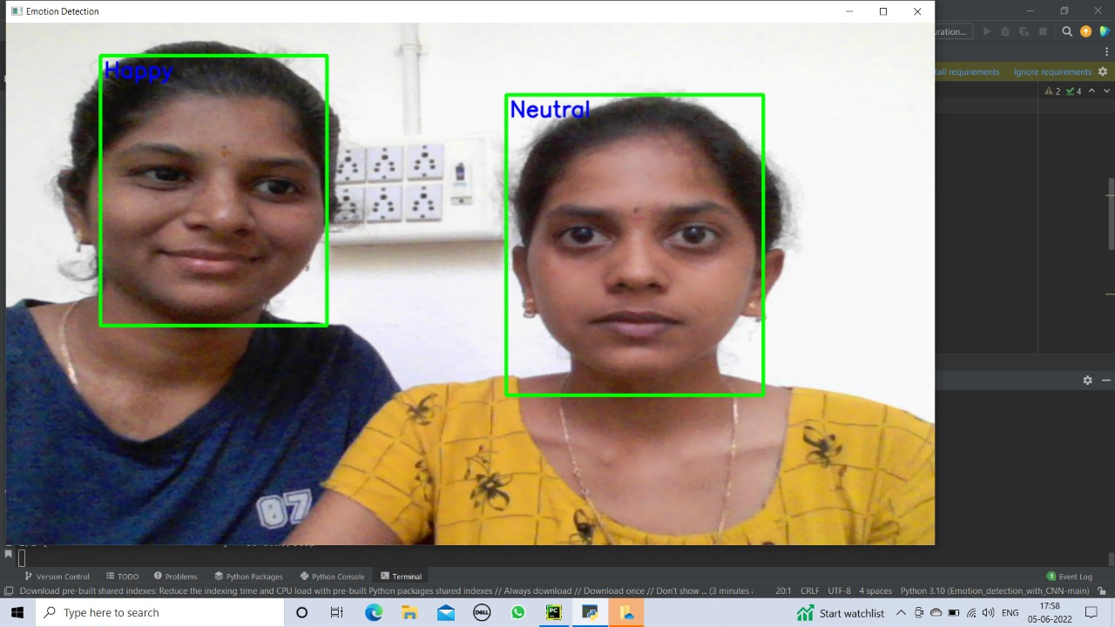
Contd…
For the detection of the face we use algorithm like Haar-Cascade, which is widely used for face detection.
Here we are trying to capture the emotions of the multiple persons in a single image at a time. The captured images of the persons or people can be obtained as below.

Slide 15
Conclusion
In this we propose a facial emotion recognition method using a CNN model which extracts facial features effectively.
Compared to traditional methods, the proposed method can automatically learn features. The FER2013 dataset was used and 35,000 images for emotions selected.
The emotions considered were happy, sad, angry, surprise, fear, disgust and neutral. These images were converted into NumPy arrays.
A CNN model was developed with four phases where the first three phases had convolution, pooling, batch normalization and dropout layers. The final phase consists of flatten, dense and output layers.

Slide 16
Contd….
So in this as we are using CNN model for capturing the facial expressions of the persons i.e, multiple facial expressions at a time when the person is in front of the webcam.
The included expressions are the angry, sad, happy, surprise, disgust, neutral.

Slide 17
References
[1] D. Yang, Abeer Alsadoon, P.W.C.Prasad-2018. “An Emotion Recognition Model Based on Facial Recognition in Virtual Learning Environment”.
[2] Hongli Zhang, Alireza Jolfaei, Mamoun Alazab,Oct-2019. “A Face Emotion Recognition Method Using Convolutional Neural Network and Image Edge Computing”.
[3] Akriti Jaiswal, A. Krishnama Raju, Suman Deb,Aug-2020. “Facial Emotion Detection Using Deep Learning”

Slide 18
Contd…
[4]Agnana Mitra, Souvik Choudhury, Susmisa Moitra ,May-2018. “Image Processing Facial Expression Recognition”.
[5] Ninad Mehendale1 “Facial emotion recognition using convolutional neural networks (FERC)”
Dataset link: https://www.kaggle.com/datasets/msambare/fer2013

Slide 19
Thank You!!!

